Slide 2
Open 08-List-Columns.Rmd

Slide 3

gapminder
A subset of the data available at Hans Rosling’s gapminder.org
R package
# install.packages("gapminder")
library(gapminder)
CC BY-SA RStudio

Slide 4
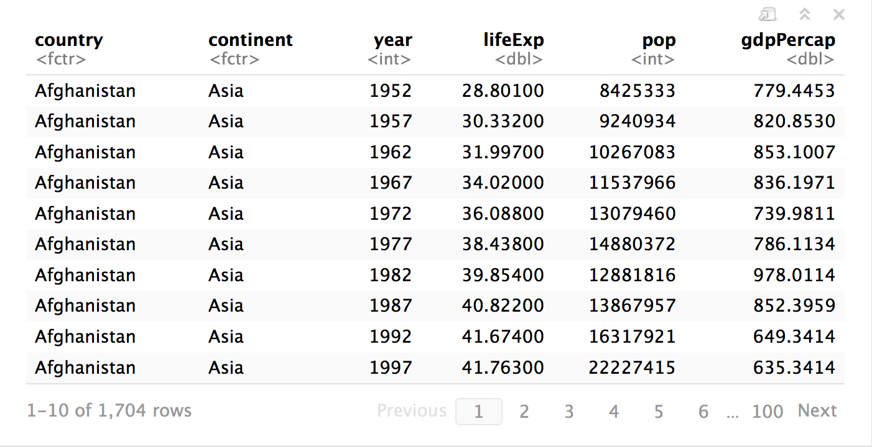
gapminder
CC BY-SA RStudio

Slide 5
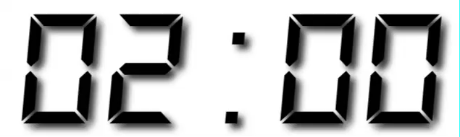
Your Turn 1
How has life expectancy changed since 1952?
Make a line plot of lifeExp vs. year grouped by country. Set alpha to 0.2, to see the results better.

Slide 6
gapminder %>%
ggplot(mapping = aes(x = year, y = lifeExp, group = country)) +
geom_line(alpha = 0.2)
CC BY-SA RStudio

Slide 7
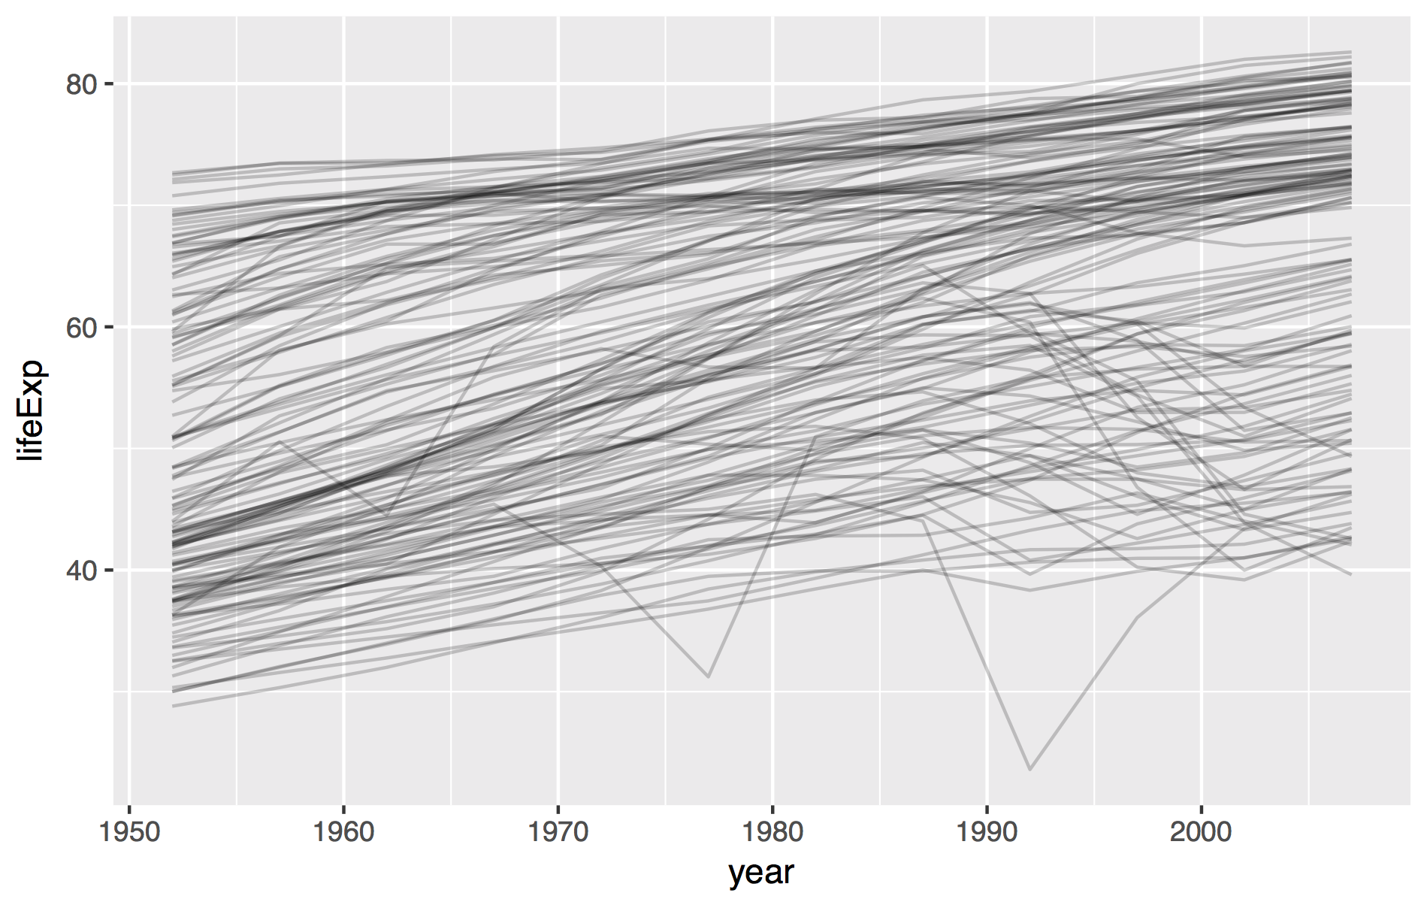
CC BY-SA RStudio

Slide 8
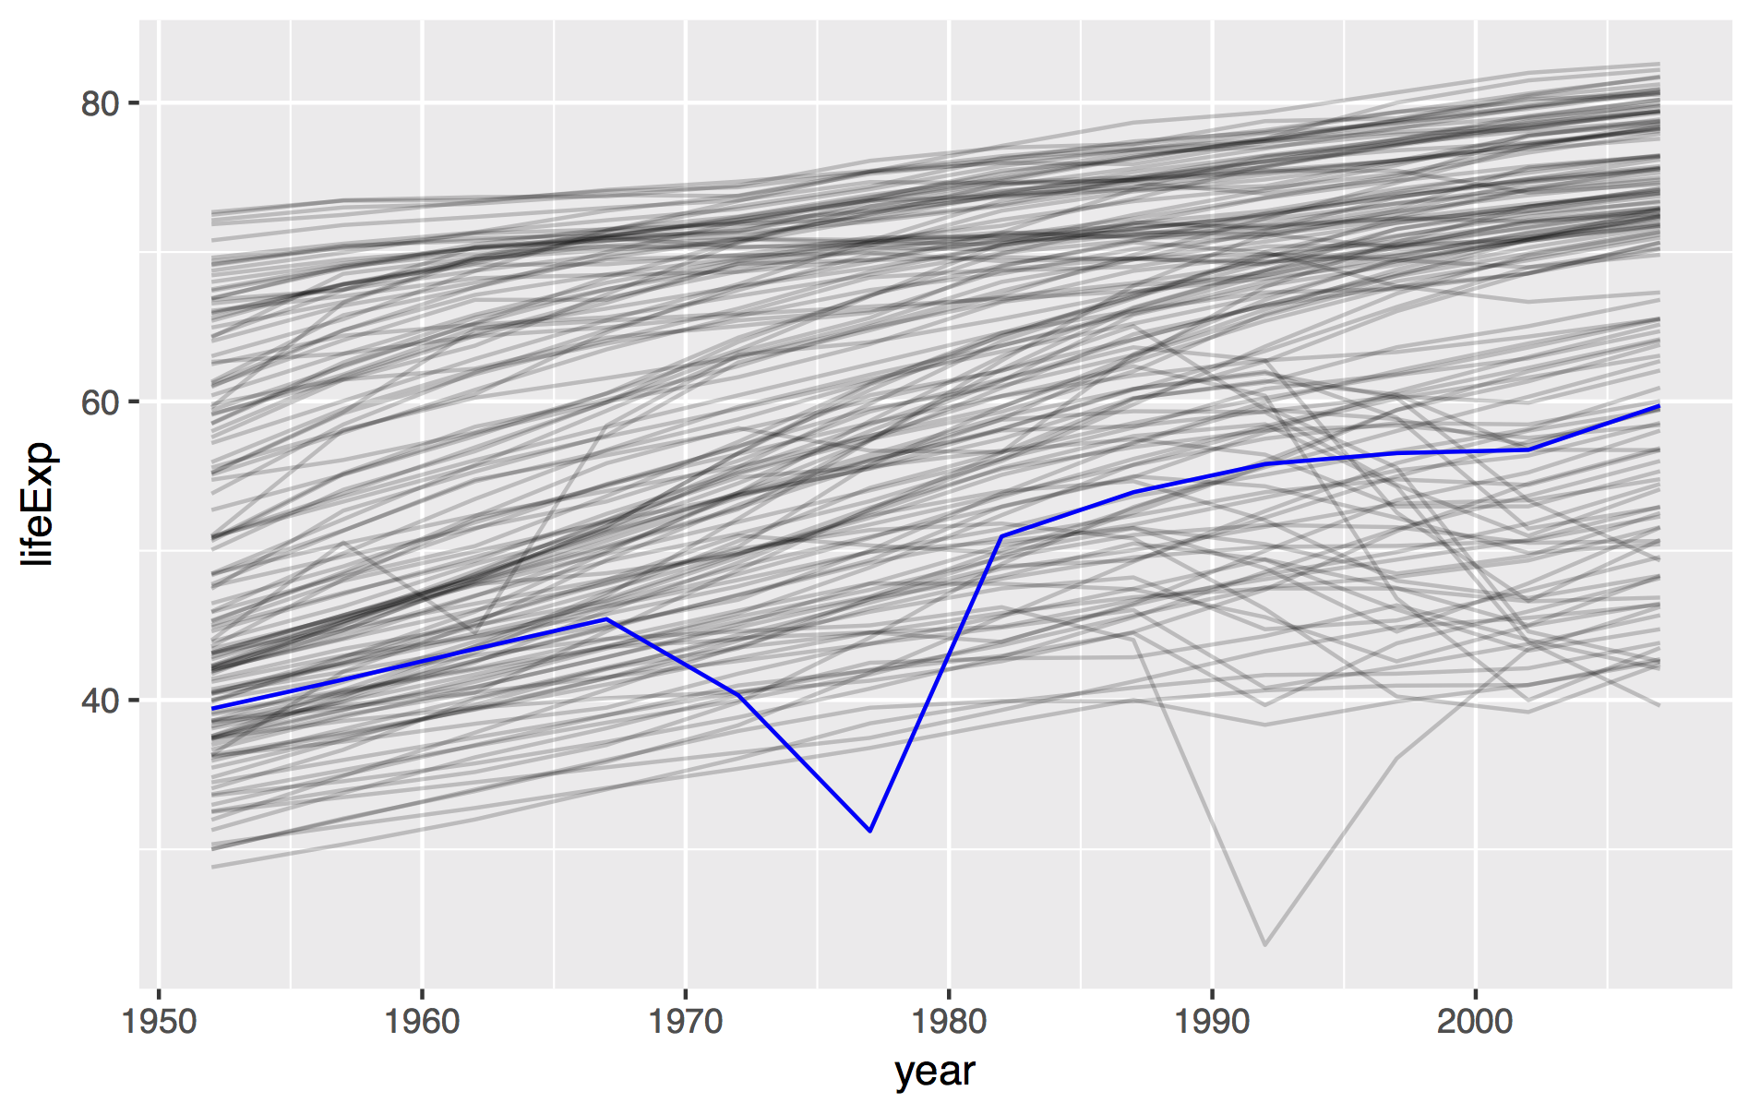
CC BY-SA RStudio

Slide 9
CC BY-SA RStudio

Slide 10
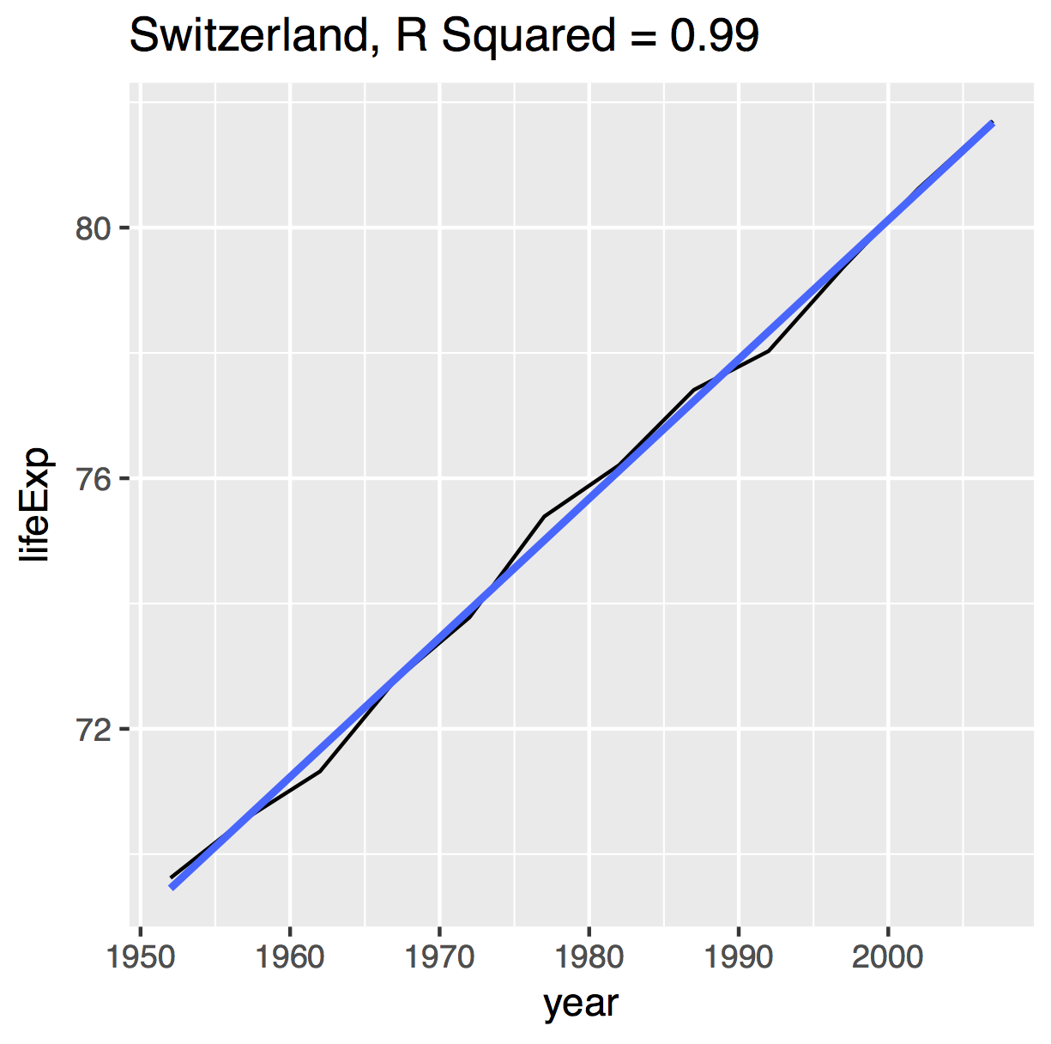
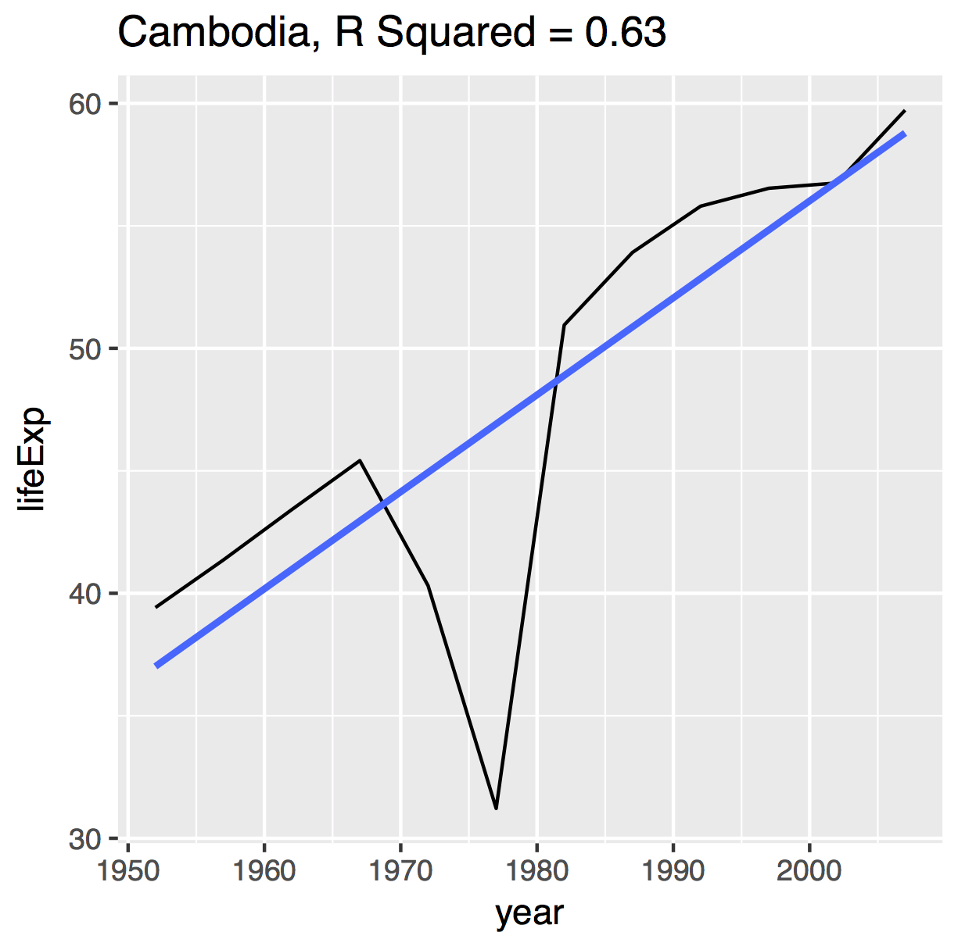
Idea 1
To quantify "linearity," fit a linear model, compare r-squared.
CC BY-SA RStudio

Slide 11
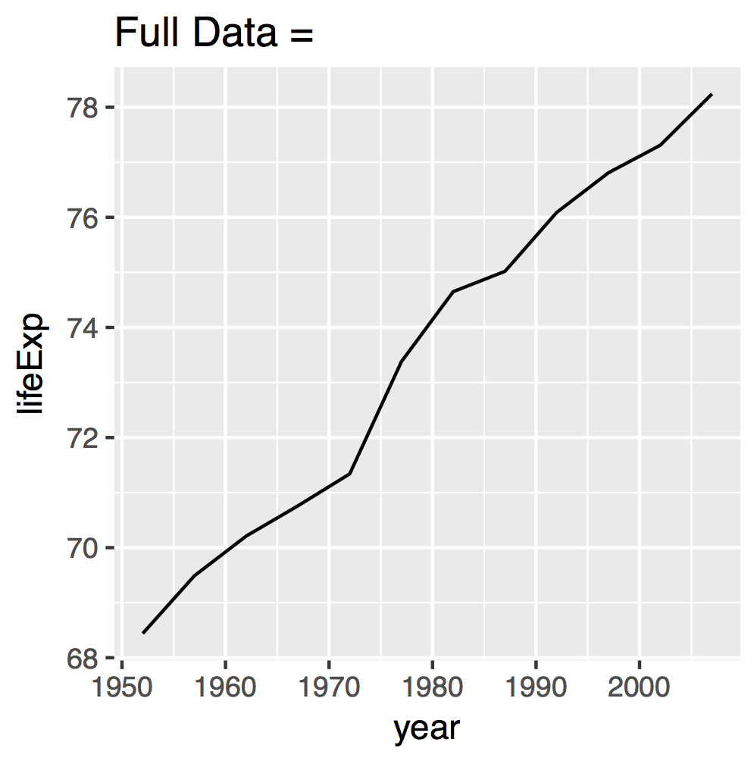
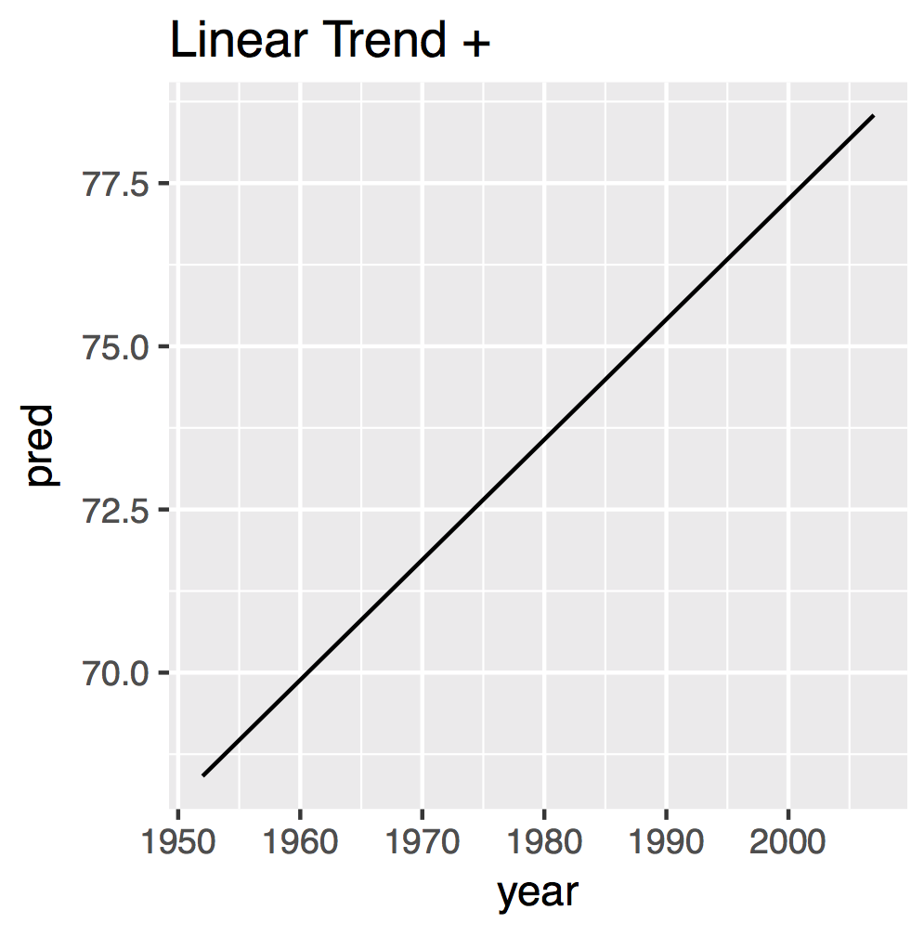
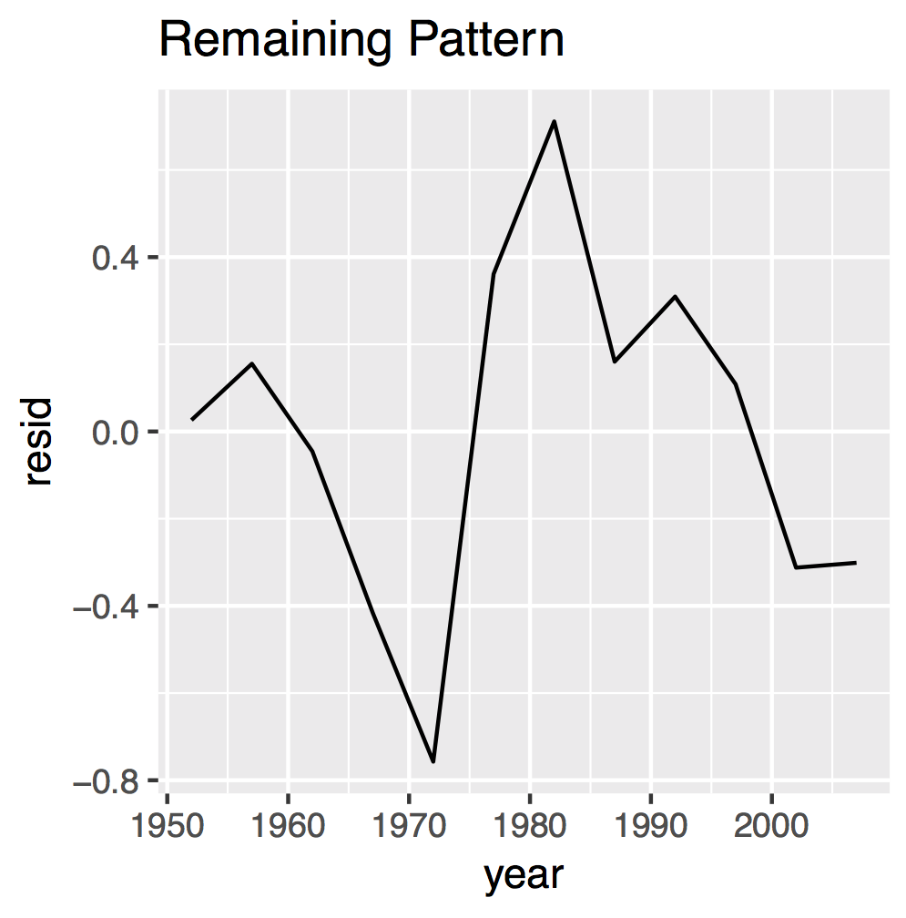
Idea 2
Use residuals to study deviations from the trend to study country specific patterns.
CC BY-SA RStudio

Slide 12
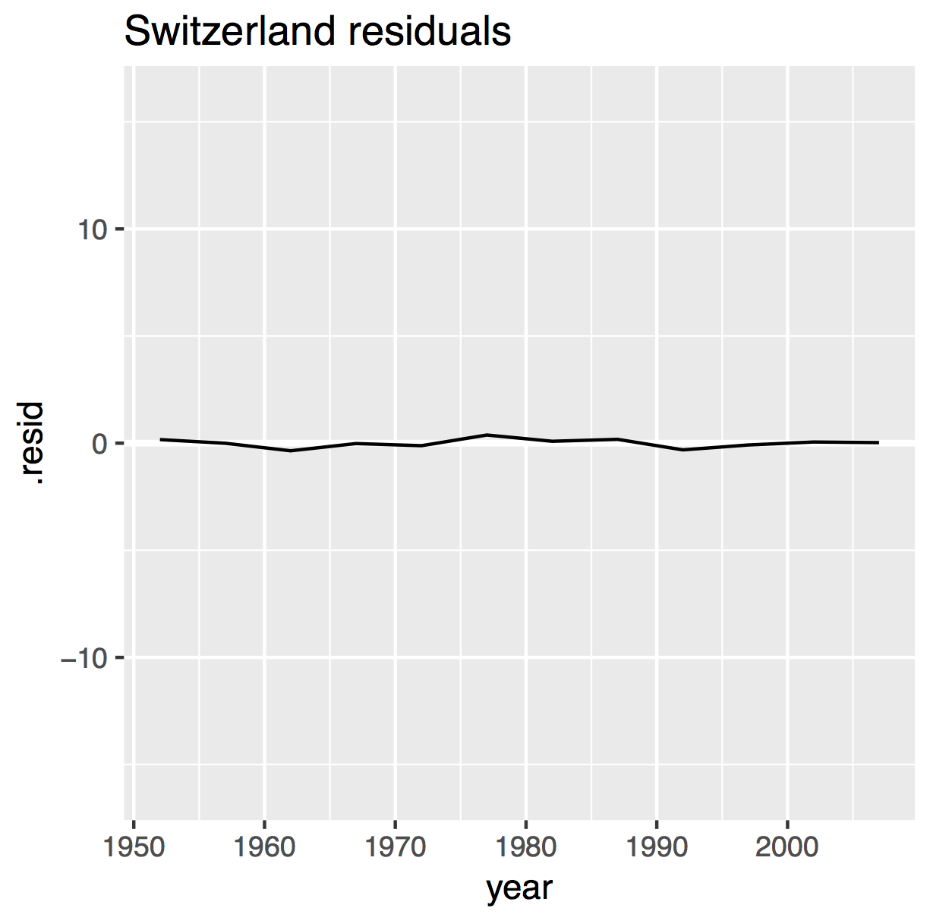
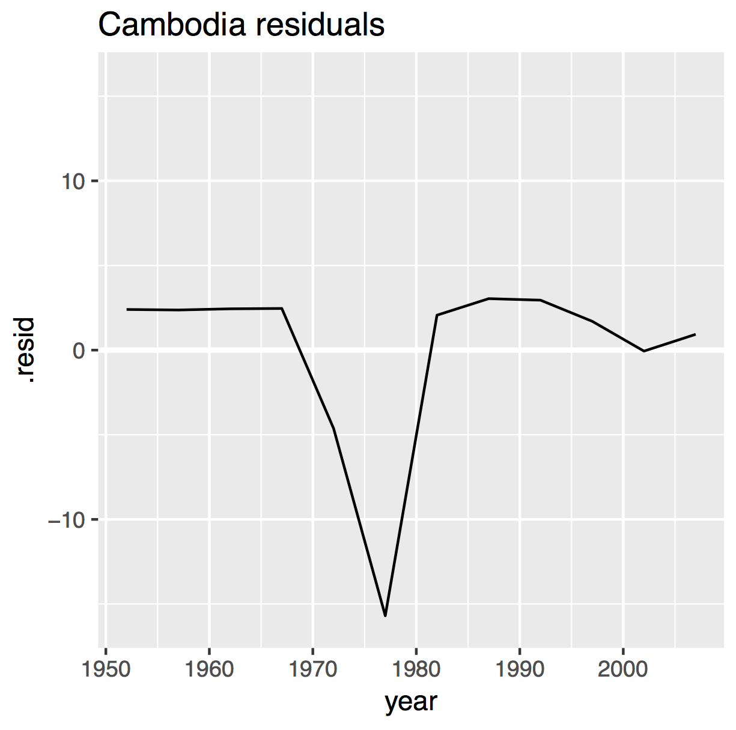
Idea 2
Use residuals to study deviations from the trend to study country specific patterns.
CC BY-SA RStudio

Slide 13
Goal
Fit model, compute r.squared, collect residuals for every country.
1. dplyr grouping toolkit
2. purrr toolkit and list columns
CC BY-SA RStudio

Slide 14
us <- gapminder %>% filter(country == "United States")
us_mod <- us %>% lm(lifeExp ~ year, data = .)
us %>%
ggplot() +
geom_line(aes(year, lifeExp))
us %>%
add_predictions(us_mod) %>%
ggplot() +
geom_line(aes(year, pred))
us %>%
add_residuals(us_mod) %>%
ggplot() +
geom_line(aes(year, resid))
CC BY-SA RStudio

Slide 15
dplyr do()

Slide 16
group_by() + do()
Run an expression on each group. The expression should return a data frame.
do(data, expression)
A grouped data frame
An R expression that returns a data frame
Use a "." in the expression to pass input (like a pipe)
CC BY-SA RStudio

Slide 17
group_by() + do()
Run an expression on each group. The expression should return a data frame.
gapminder %>%
group_by(country, continent) %>%
do()
A grouped data frame
CC BY-SA RStudio

Slide 18
group_by() + do()
Run an expression on each group. The expression should return a data frame.
gapminder %>%
group_by(country, continent) %>%
do(lm(lifeExp ~ year, data = .))
A grouped data frame
An R expression that uses a "." to pass input
but DOES NOT return a data frame
CC BY-SA RStudio

Slide 19
group_by() + do()
Run an expression on each group. The expression should return a data frame.
gapminder %>%
group_by(country, continent) %>%
do(glance(lm(lifeExp ~ year, data = .)))
A grouped data frame
An R expression that uses a "." to pass input
…and returns a data frame
CC BY-SA RStudio

Slide 20
group_by() + do()
Run an expression on each group. The expression should return a data frame.
gapminder %>%
group_by(country, continent) %>%
do(lm(lifeExp ~ year, data = .) %>% glance())
A grouped data frame
An R expression that uses a "." to pass input
…and returns a data frame
CC BY-SA RStudio

Slide 21
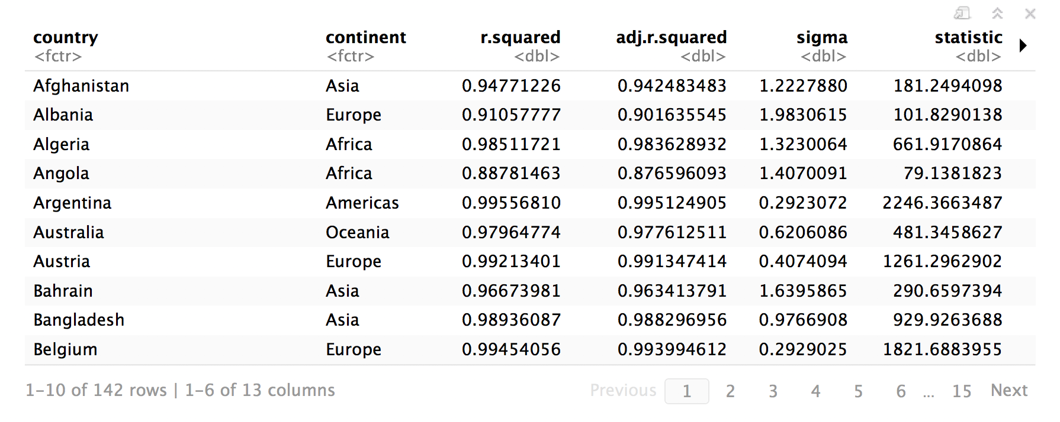
group_by() + do()
gapminder %>%
group_by(country, continent) %>%
do(lm(lifeExp ~ year, data = .) %>% glance())
CC BY-SA RStudio

Slide 22
group_by() + do()
gapminder %>%
group_by(country, continent) %>%
do(lm(lifeExp ~ year, data = .) %>% glance())
CC BY-SA RStudio

Slide 23
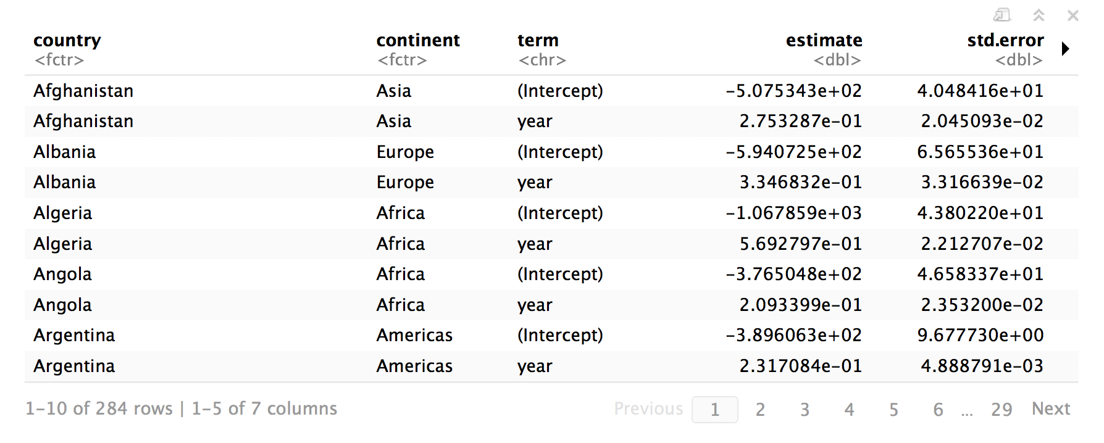
group_by() + do()
gapminder %>%
group_by(country, continent) %>%
do(lm(lifeExp ~ year, data = .) %>% tidy())
CC BY-SA RStudio

Slide 24
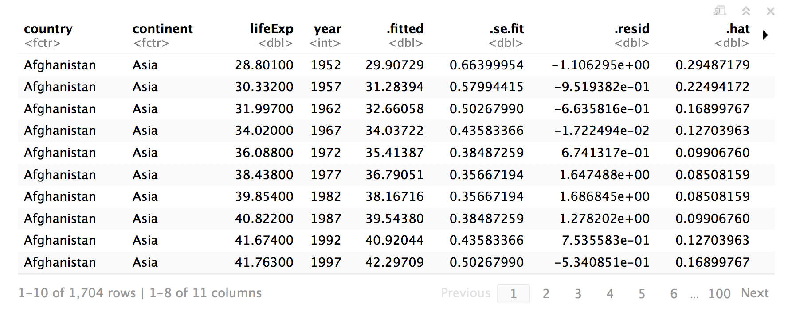
group_by() + do()
gapminder %>%
group_by(country, continent) %>%
do(lm(lifeExp ~ year, data = .) %>% augment())
CC BY-SA RStudio

Slide 25
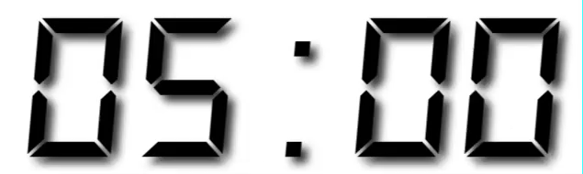
Your Turn 2
Group the data by country and continent then fit a model and collect the residuals for each country.
Plot the residuals vs year as a line graph, grouped by country, with alpha = 0.2.
Add the following to your plot to facet by continent:
+ facet_wrap(~continent)

Slide 26
gapminder %>%
group_by(country, continent) %>%
do(lm(lifeExp ~ year, data = .) %>% augment()) %>%
ggplot() +
geom_line(aes(year, .resid, group = country), alpha = 0.2) +
facet_wrap(~continent)
CC BY-SA RStudio

Slide 27
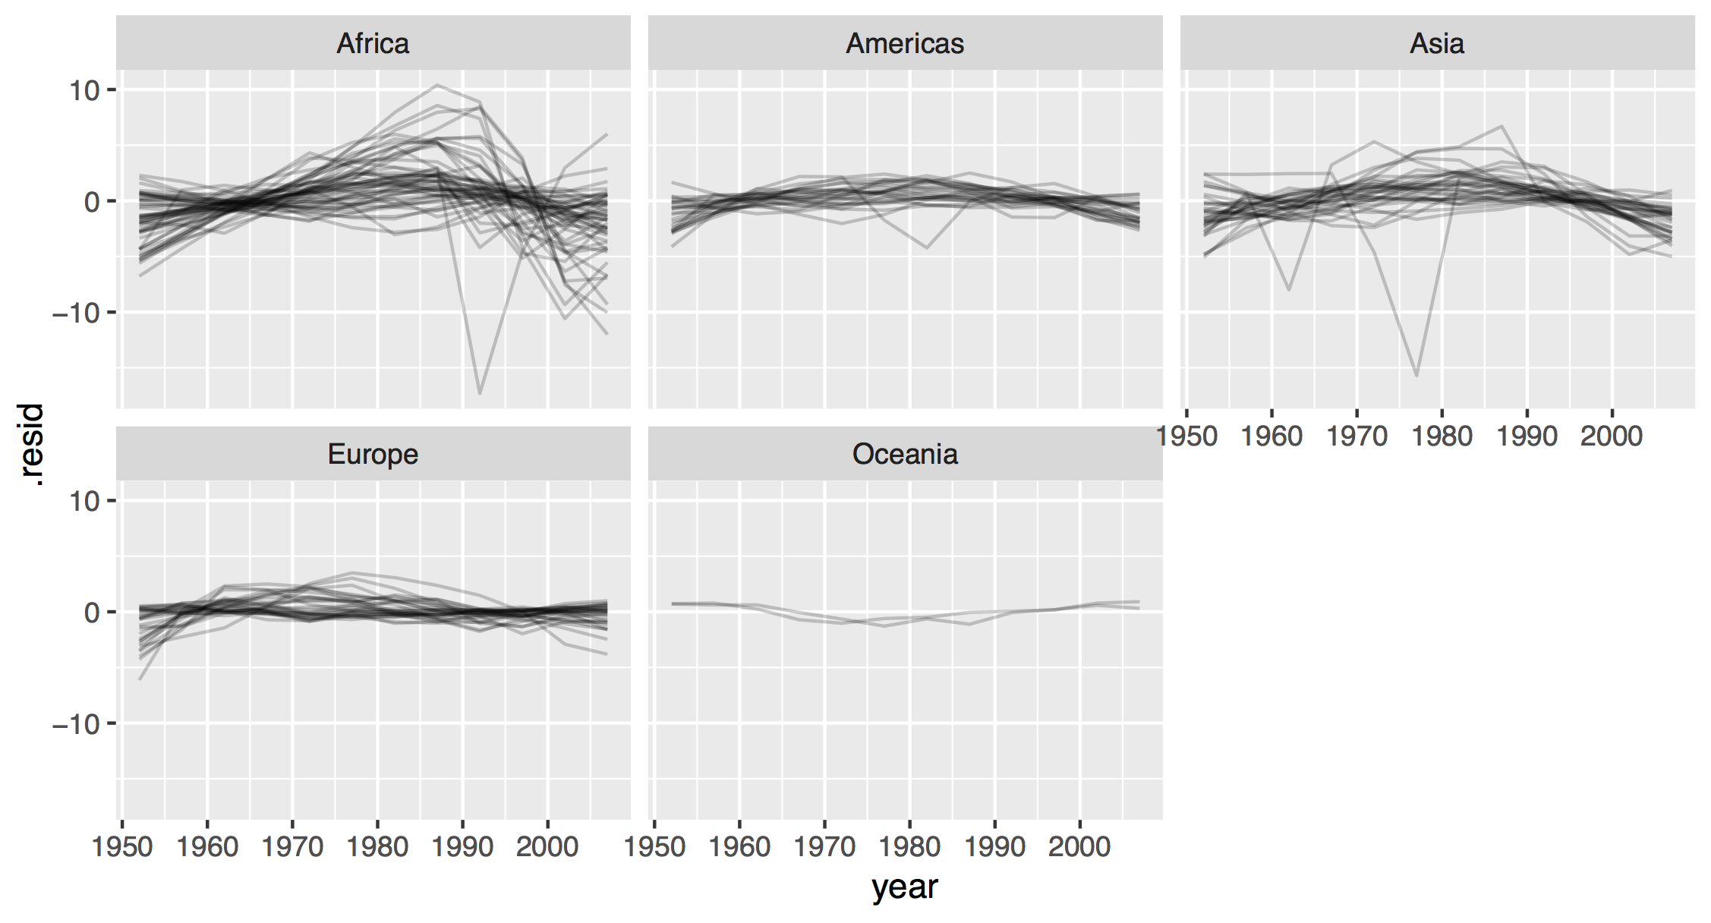
CC BY-SA RStudio

Slide 28
Quiz
Which broom function can we use to find the r squared for each model?

Slide 29
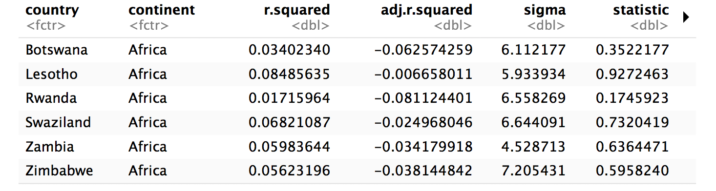
Bad fits
Which countries had a non-linear progress?
gapminder %>%
group_by(country, continent) %>%
do(lm(lifeExp ~ year, data = .) %>% glance()) %>%
filter(r.squared < 0.25)
CC BY-SA RStudio

Slide 30
Your Turn 3
Complete the code to filter the dataset that you made in Your Turn 2 against bad_fits.
Use the result to plot a line graph of year vs. .resid colored by country for each country that had an r-squared < 0.25.

Slide 31
bad_fits <- gapminder %>%
group_by(country) %>%
do(lm(lifeExp ~ year, data = .) %>% glance()) %>%
filter(r.squared < 0.25)
residuals <- gapminder %>%
group_by(country) %>%
do(lm(lifeExp ~ year, data = .) %>% augment())
residuals %>%
semi_join(bad_fits) %>%
ggplot() +
geom_line(aes(year, .resid, color = country))
CC BY-SA RStudio

Slide 32
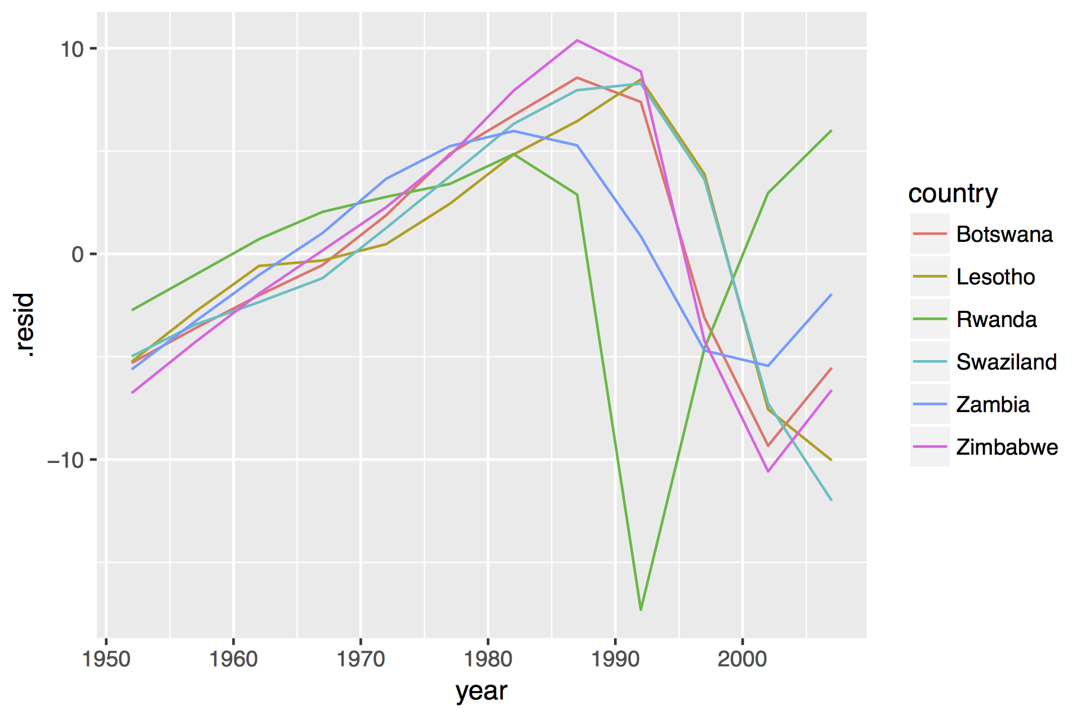
CC BY-SA RStudio

Slide 33
bad_fits <- gapminder %>%
group_by(country, continent) %>%
do(lm(lifeExp ~ year, data = .) %>% glance()) %>%
filter(r.squared < 0.25)
residuals <- gapminder %>%
group_by(country, continent) %>%
do(lm(lifeExp ~ year, data = .) %>% augment())
residuals %>%
semi_join(bad_fits) %>%
ggplot() +
geom_line(aes(year, .resid, color = country))
Fits the same model twice (to 142 countries each time)
CC BY-SA RStudio

Slide 34
bad_fits <- gapminder %>%
group_by(country, continent) %>%
do(lm(lifeExp ~ year, data = .) %>% glance()) %>%
filter(r.squared < 0.25)
residuals <- gapminder %>%
group_by(country, continent) %>%
do(lm(lifeExp ~ year, data = .) %>% augment())
residuals %>%
semi_join(bad_fits) %>%
ggplot() +
geom_line(aes(year, .resid, color = country))
Fits the same model twice (to 142 countries each time)
Need to keep track of two separate data frames
CC BY-SA RStudio

Slide 35

List columns

Slide 36
bad_fits
residuals
country | r.squared
Botswana | 0.03
Lesotho | 0.08
Rwanda | 0.02
Swaziland | 0.07
Zambia | 0.06
Zimbabwe | 0.06
country | year | .resid
Botswana | 1952 | -5.3071154
Botswana | 1957 | -3.6144580
Botswana | 1962 | -2.0158007
Botswana | 1967 | -0.5411434
Botswana | 1972 | 1.8815140
Botswana | 1977 | 4.8731713
Botswana | 1982 | 6.7348287
Botswana | 1987 | 8.5694860
Botswana | 1992 | 7.3891434
Botswana | 1997 | -3.1031993
Botswana | 2002 | -9.3285420
Botswana | 2007 | -5.5378846
Lesotho | 1952 | -5.2410256
Lesotho | 1957 | -2.8098543
Lesotho | 1962 | -0.5876830
Lesotho | 1967 | -0.3205117
Lesotho | 1972 | 0.4766597
Lesotho | 1977 | 2.4398310
Lesotho | 1982 | 4.8320023
Lesotho | 1987 | 6.4561737
Lesotho | 1992 | 8.4833450
Lesotho | 1997 | 3.8785163
Lesotho | 2002 | -7.5643124
Lesotho | 2007 | -10.0431410
Rwanda | 1952 | -2.7419487
Rwanda | 1957 | -1.0127914
Rwanda | 1962 | 0.7163660
Rwanda | 1967 | 2.0455233
Rwanda | 1972 | 2.7746807
Rwanda | 1977 | 3.4038380
Rwanda | 1982 | 4.8509953
Rwanda | 1987 | 2.8821527
Rwanda | 1992 | -17.3096900
Rwanda | 1997 | -4.5925326
Rwanda | 2002 | 2.9626247
Rwanda | 2007 | 6.0207821
Swaziland | 1952 | -4.9808590
Swaziland | 1957 | -3.4392331
Swaziland | 1962 | -2.3466072
Swaziland | 1967 | -1.1809814
Swaziland | 1972 | 1.2626445
Swaziland | 1977 | 3.7722704
Swaziland | 1982 | 6.3208963
Swaziland | 1987 | 7.9625221
Swaziland | 1992 | 8.2831480
Swaziland | 1997 | 3.6227739
Swaziland | 2002 | -7.2726002
Swaziland | 2007 | -12.0039744
Zambia | 1952 | -5.6200256
Zambia | 1957 | -3.2788998
Zambia | 1962 | -1.0307739
Zambia | 1967 | 1.0163520
Zambia | 1972 | 3.6574779
Zambia | 1977 | 5.2386037
Zambia | 1982 | 5.9757296
Zambia | 1987 | 5.2778555
Zambia | 1992 | 0.8589814
Zambia | 1997 | -4.7008928
Zambia | 2002 | -5.4437669
Zambia | 2007 | -1.9506410
Zimbabwe | 1952 | -6.7702436
Zimbabwe | 1957 | -4.2871387
Zimbabwe | 1962 | -1.9330338
Zimbabwe | 1967 | 0.1690711
Zimbabwe | 1972 | 2.2741760
Zimbabwe | 1977 | 4.7782809
Zimbabwe | 1982 | 7.9323858
Zimbabwe | 1987 | 10.3854907
Zimbabwe | 1992 | 8.8765956
Zimbabwe | 1997 | -4.2262995
Zimbabwe | 2002 | -10.5811946
CC BY-SA RStudio

Slide 37
master
country | r.squared | data
Botswana | 0.03
Lesotho | 0.08
Rwanda | 0.02
year | .resid
1952 | -5.3071154
1957 | -3.6144580
1962 | -2.0158007
1967 | -0.5411434
1972 | 1.8815140
1977 | 4.8731713
1982 | 6.7348287
1987 | 8.5694860
1992 | 7.3891434
1997 | -3.1031993
2002 | -9.3285420
2007 | -5.5378846
year | .resid
1952 | -5.2410256
1957 | -2.8098543
1962 | -0.5876830
1967 | -0.3205117
1972 | 0.4766597
1977 | 2.4398310
1982 | 4.8320023
1987 | 6.4561737
1992 | 8.4833450
1997 | 3.8785163
2002 | -7.5643124
2007 | -10.0431410
year | .resid
1952 | -2.7419487
1957 | -1.0127914
1962 | 0.7163660
1967 | 2.0455233
1972 | 2.7746807
1977 | 3.4038380
1982 | 4.8509953
1987 | 2.8821527
1992 | -17.3096900
1997 | -4.5925326
2002 | 2.9626247
2007 | 6.0207821
CC BY-SA RStudio

Slide 38
master
country | r.squared | data | model
Botswana | 0.03
Lesotho | 0.08
Rwanda | 0.02
year | .resid
1952 | -5.3071154
1957 | -3.6144580
1962 | -2.0158007
1967 | -0.5411434
1972 | 1.8815140
1977 | 4.8731713
1982 | 6.7348287
1987 | 8.5694860
1992 | 7.3891434
1997 | -3.1031993
2002 | -9.3285420
2007 | -5.5378846
Call:
lm(formula = lifeExp ~ year, data = .)
Coefficients:
(Intercept) year
-65.49586 0.06067
year | .resid
1952 | -5.2410256
1957 | -2.8098543
1962 | -0.5876830
1967 | -0.3205117
1972 | 0.4766597
1977 | 2.4398310
1982 | 4.8320023
1987 | 6.4561737
1992 | 8.4833450
1997 | 3.8785163
2002 | -7.5643124
2007 | -10.0431410
Call:
lm(formula = lifeExp ~ year, data = .)
Coefficients:
(Intercept) year
-139.16529 0.09557
year | .resid
1952 | -2.7419487
1957 | -1.0127914
1962 | 0.7163660
1967 | 2.0455233
1972 | 2.7746807
1977 | 3.4038380
1982 | 4.8509953
1987 | 2.8821527
1992 | -17.3096900
1997 | -4.5925326
2002 | 2.9626247
2007 | 6.0207821
CC BY-SA RStudio
Call:
lm(formula = lifeExp ~ year, data = .)
Coefficients:
(Intercept) year
-139.16529 0.09557

Slide 39
Quiz
How is a data frame/tibble similar to a list?

Slide 40

A data frame/tibble is a list!
List
data frame
num | cha | log
1 | "one" | TRUE
2 | "two" | FALSE
3 | "three" | FALSE
1
2
3
double
=
"one"
"two"
"three"
character
TRUE
FALSE
FALSE
logical
+ class = "data.frame"
CC BY-SA RStudio

Slide 41
A data frame/tibble is a list!
data frame
df["num"]
df[["num"]]
num | cha | log
1 | "one" | TRUE
2 | "two" | FALSE
3 | "three" | FALSE
df$num
num
1
2
3
c(1, 2, 3)
CC BY-SA RStudio

Slide 42
A data frame/tibble is a list!
data frame
df %>% select(num)
num | cha | log
1 | "one" | TRUE
2 | "two" | FALSE
3 | "three" | FALSE
num
1
2
3
?
CC BY-SA RStudio

Slide 43
Quiz
If one of the elements of a list can be another list,
can one of the columns of a data frame be another list?
List
data frame
1
2
3
double
?
num | cha | listcol
1 | "one" | 1
2 | "two" | c("1", "two", "FALSE")
3 | "three" | FALSE
=
"one"
"two"
"three"
character
1
double
"1"
"two"
"FALSE"
character
list
FALSE
logical

Slide 44
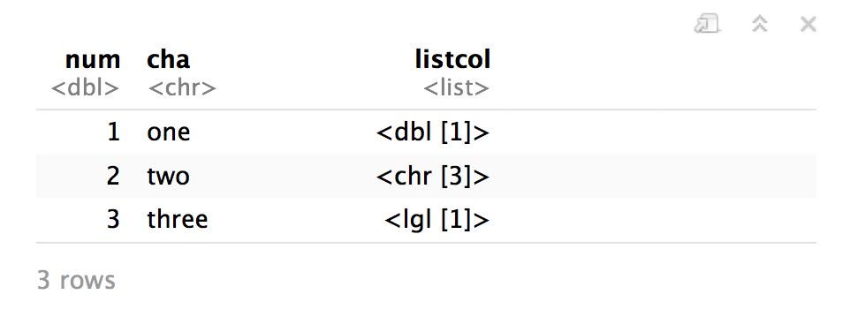
Yes.
tibble(
num = c(1, 2, 3),
cha = c("one", "two", "three"),
listcol = list(1, c("1", "two", "FALSE"), FALSE)
)
CC BY-SA RStudio

Slide 45
nesting

Slide 46
nest()
Nest rows into a list column by group.
nest(data,.key = "data")
A grouped data frame
name for the new list column
CC BY-SA RStudio

Slide 47
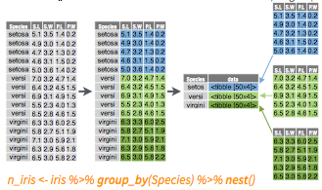
nest()
Places grouped cases into a list column.
gapminder %>%
group_by(country) %>%
nest()
CC BY-SA RStudio

Slide 48
nest()
residuals %>%
group_by(country) %>%
nest()
country | year | .resid
Botswana | 1952 | -5.3071154
Botswana | 1957 | -3.6144580
Botswana | 1962 | -2.0158007
Botswana | 1967 | -0.5411434
Botswana | 1972 | 1.8815140
Botswana | 1977 | 4.8731713
Botswana | 1982 | 6.7348287
Botswana | 1987 | 8.5694860
Botswana | 1992 | 7.3891434
Botswana | 1997 | -3.1031993
Botswana | 2002 | -9.3285420
Botswana | 2007 | -5.5378846
Lesotho | 1952 | -5.2410256
Lesotho | 1957 | -2.8098543
Lesotho | 1962 | -0.5876830
Lesotho | 1967 | -0.3205117
Lesotho | 1972 | 0.4766597
Lesotho | 1977 | 2.4398310
Lesotho | 1982 | 4.8320023
Lesotho | 1987 | 6.4561737
Lesotho | 1992 | 8.4833450
Lesotho | 1997 | 3.8785163
Lesotho | 2002 | -7.5643124
Lesotho | 2007 | -10.0431410
Rwanda | 1952 | -2.7419487
Rwanda | 1957 | -1.0127914
Rwanda | 1962 | 0.7163660
Rwanda | 1967 | 2.0455233
Rwanda | 1972 | 2.7746807
Rwanda | 1977 | 3.4038380
Rwanda | 1982 | 4.8509953
Rwanda | 1987 | 2.8821527
Rwanda | 1992 | -17.3096900
Rwanda | 1997 | -4.5925326
Rwanda | 2002 | 2.9626247
Rwanda | 2007 | 6.0207821
Swaziland | 1952 | -4.9808590
Swaziland | 1957 | -3.4392331
Swaziland | 1962 | -2.3466072
Swaziland | 1967 | -1.1809814
Swaziland | 1972 | 1.2626445
Swaziland | 1977 | 3.7722704
Swaziland | 1982 | 6.3208963
Swaziland | 1987 | 7.9625221
Swaziland | 1992 | 8.2831480
Swaziland | 1997 | 3.6227739
Swaziland | 2002 | -7.2726002
Swaziland | 2007 | -12.0039744
Zambia | 1952 | -5.6200256
Zambia | 1957 | -3.2788998
Zambia | 1962 | -1.0307739
Zambia | 1967 | 1.0163520
Zambia | 1972 | 3.6574779
Zambia | 1977 | 5.2386037
Zambia | 1982 | 5.9757296
Zambia | 1987 | 5.2778555
Zambia | 1992 | 0.8589814
Zambia | 1997 | -4.7008928
Zambia | 2002 | -5.4437669
Zambia | 2007 | -1.9506410
Zimbabwe | 1952 | -6.7702436
Zimbabwe | 1957 | -4.2871387
Zimbabwe | 1962 | -1.9330338
Zimbabwe | 1967 | 0.1690711
Zimbabwe | 1972 | 2.2741760
Zimbabwe | 1977 | 4.7782809
Zimbabwe | 1982 | 7.9323858
Zimbabwe | 1987 | 10.3854907
Zimbabwe | 1992 | 8.8765956
Zimbabwe | 1997 | -4.2262995
Zimbabwe | 2002 | -10.5811946
country | data
Botswana
Lesotho
Rwanda
year | .resid
1952 | -5.3071154
1957 | -3.6144580
1962 | -2.0158007
1967 | -0.5411434
1972 | 1.8815140
1977 | 4.8731713
1982 | 6.7348287
1987 | 8.5694860
1992 | 7.3891434
1997 | -3.1031993
2002 | -9.3285420
2007 | -5.5378846
year | .resid
1952 | -5.2410256
1957 | -2.8098543
1962 | -0.5876830
1967 | -0.3205117
1972 | 0.4766597
1977 | 2.4398310
1982 | 4.8320023
1987 | 6.4561737
1992 | 8.4833450
1997 | 3.8785163
2002 | -7.5643124
2007 | -10.0431410
CC BY-SA RStudio
year | .resid
1952 | -2.7419487
1957 | -1.0127914
1962 | 0.7163660
1967 | 2.0455233
1972 | 2.7746807
1977 | 3.4038380
1982 | 4.8509953
1987 | 2.8821527
1992 | -17.3096900
1997 | -4.5925326
2002 | 2.9626247
2007 | 6.0207821

Slide 49
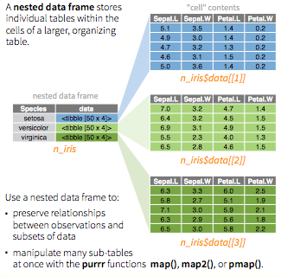

CC BY-SA RStudio

Slide 50
gapminder %>%
group_by(country) %>%
nest() %>%
# Apply model to each table in the column
mutate(model = map(function(df) lm(lifeExp ~ year, data = df)) %>%
# Extract coefficients and save in coefficient column
mutate(coefficent = map_dbl(function(df) tidy(df)$estimate[2]) %>%
# Extract adj.r.squares and save in adj_r column
mutate(adj_r = map_dbl(function(df) glance(df)$adj.r.squared))
CC BY-SA RStudio

Slide 51
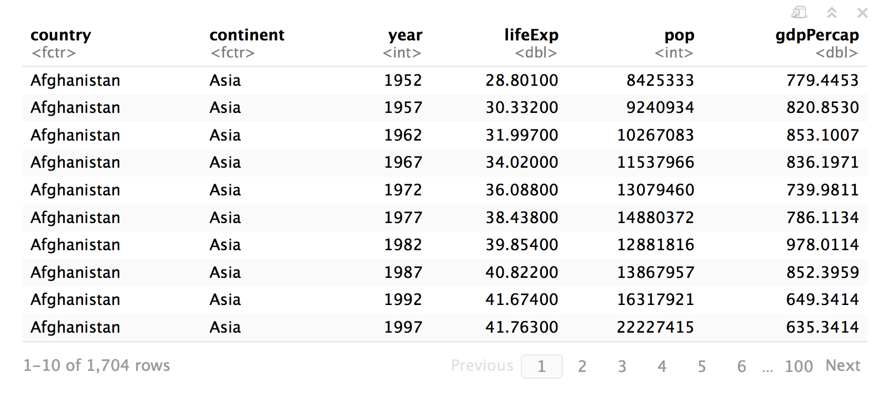
gapminder
CC BY-SA RStudio

Slide 52
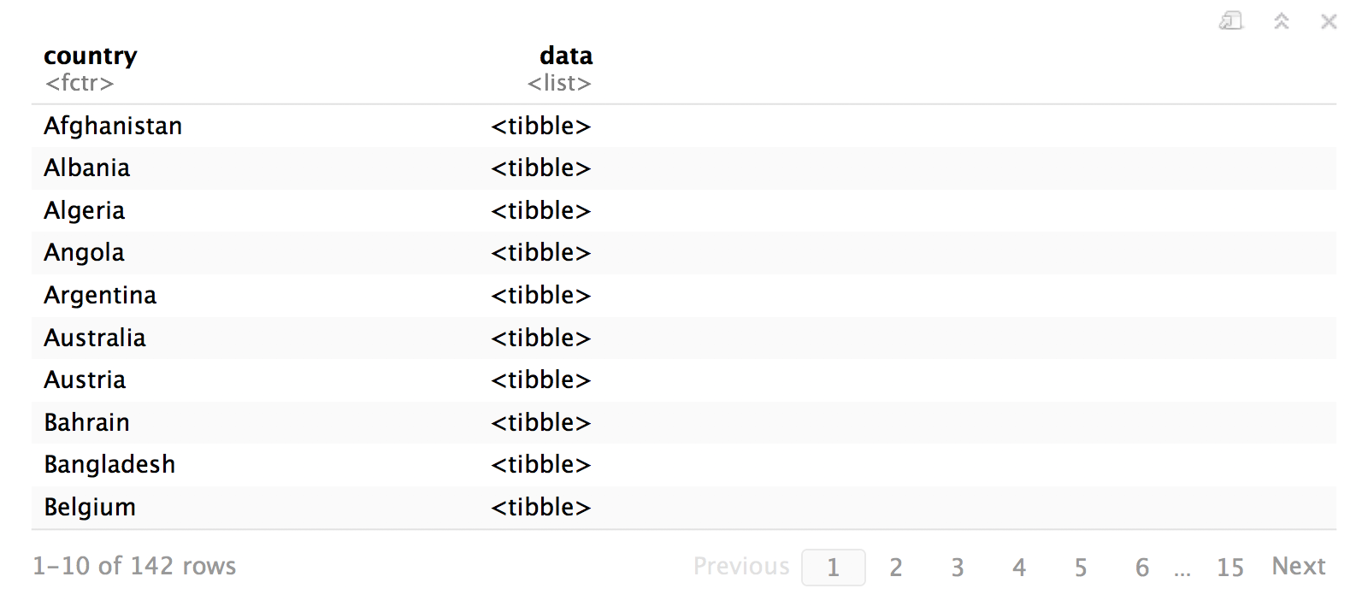
master <- gapminder %>%
group_by(country) %>%
nest()
CC BY-SA RStudio

Slide 53
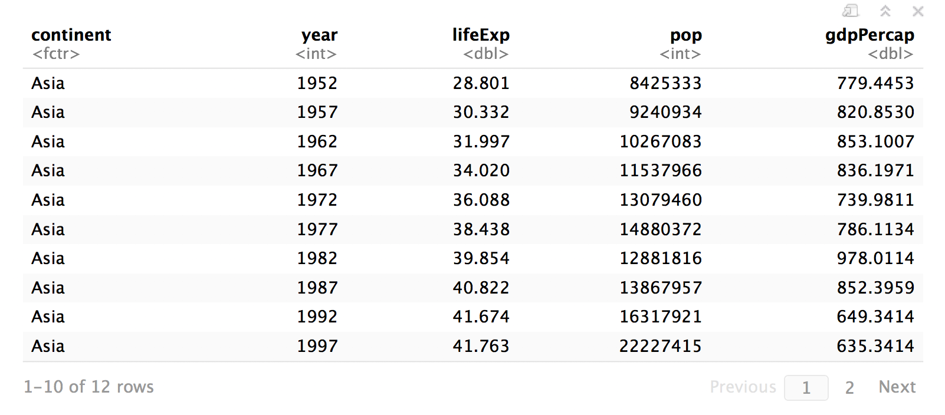
master$data[[1]]
CC BY-SA RStudio

Slide 54
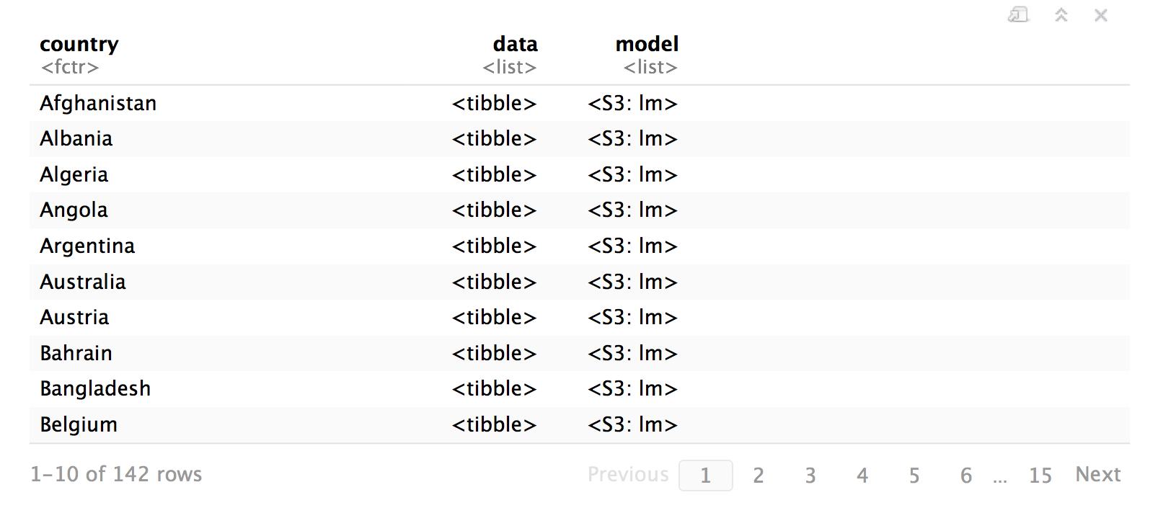
fit_model <- function(df) lm(lifeExp ~ year, data = df)
master <- master %>%
mutate(model = map(data, fit_model))
map() takes a list
…and returns a list
CC BY-SA RStudio

Slide 55
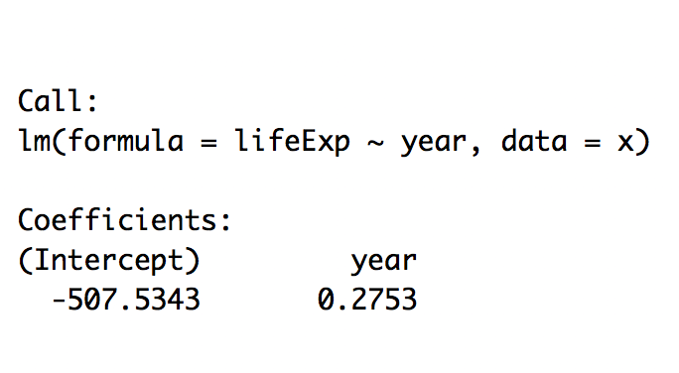
master$model[[1]]
CC BY-SA RStudio

Slide 56
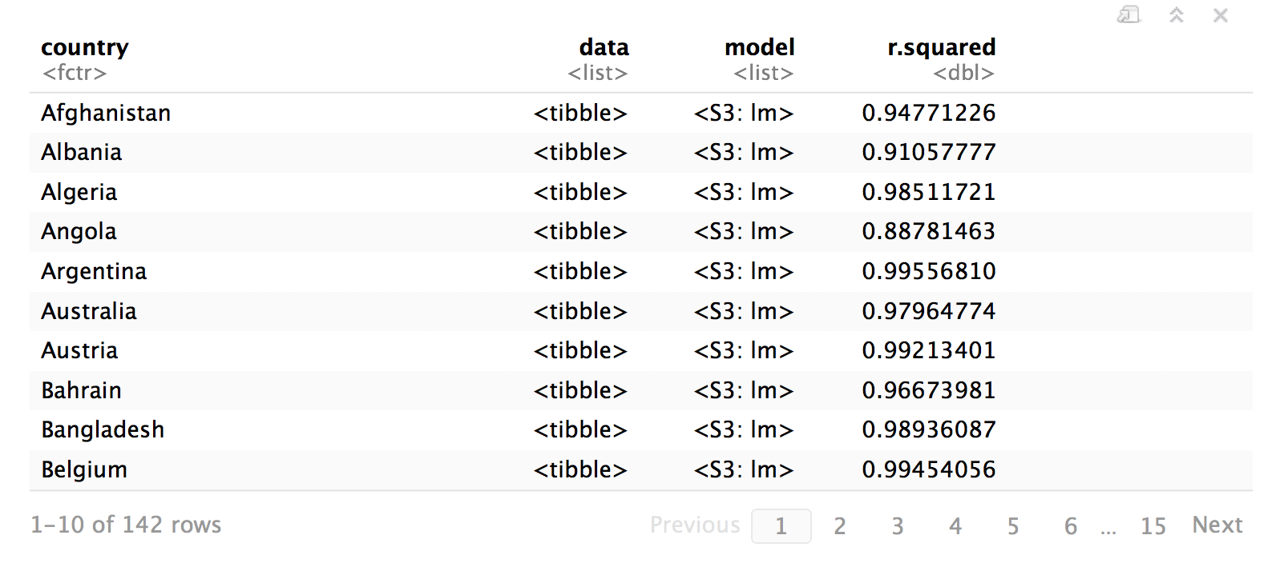
get_rsq <- function(mod) glance(mod)$r.squared
master <- master %>%
mutate(r.squared = map_dbl(model, get_rsq))
…and returns a number
map_dbl() takes a list
CC BY-SA RStudio

Slide 57
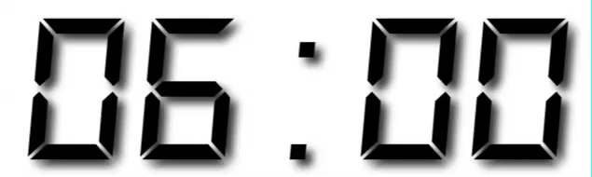
Your Turn 4
Create your own copy of master and then add one more list column: output which contains the output of augment() for each model.

Slide 58
fit_model <- function(df) lm(lifeExp ~ year, data = df)
get_rsq <- function(mod) glance(mod)$r.squared
get_output <- function(mod) augment(mod)
master <- gapminder %>%
group_by(country) %>%
nest() %>%
mutate(model = map(data, fit_model),
r.squared = map_dbl(model, get_rsq),
output = map(model, get_output))
master
CC BY-SA RStudio

Slide 59
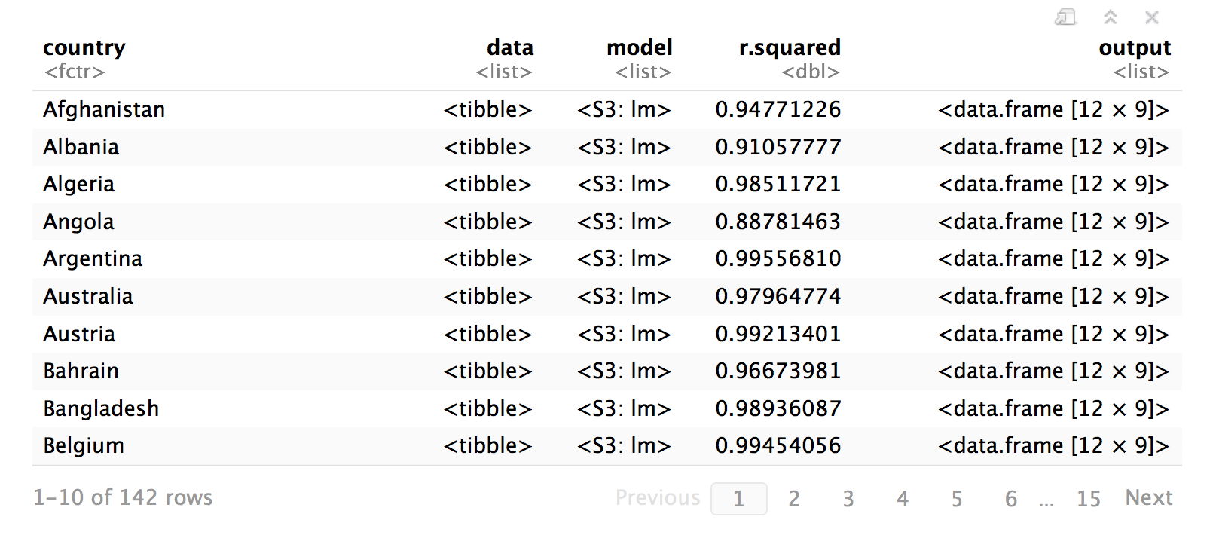
CC BY-SA RStudio

Slide 60
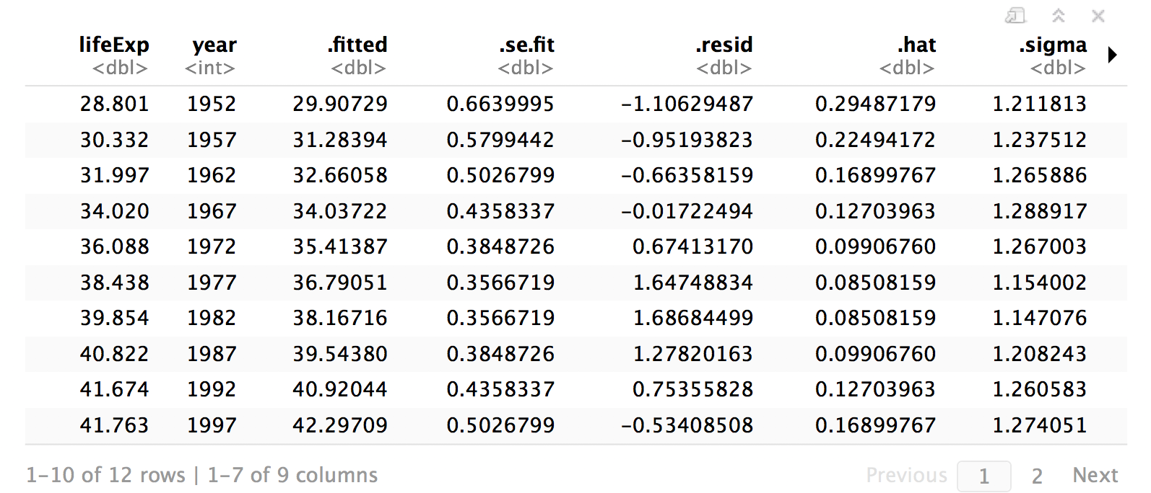
master$output[[1]]
CC BY-SA RStudio

Slide 61
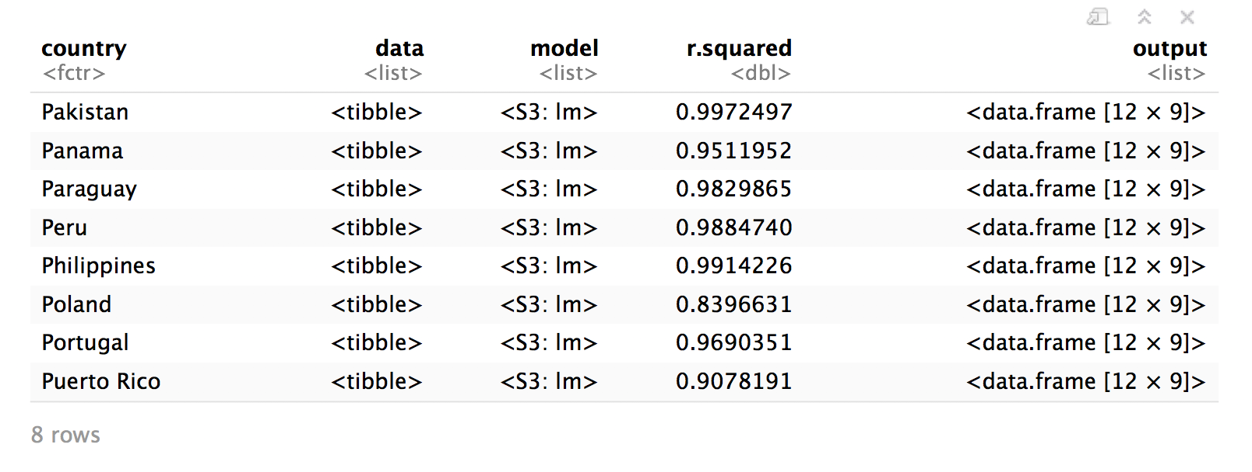
Benefits
Data and models stay in correspondence across manipulations
master %>% filter(str_sub(country, 1, 1) == "P")
But how can we plot?
CC BY-SA RStudio

Slide 62
unnest()
Unnests one or more list columns
master %>%
unnest(data, output, .drop = FALSE)
A nested data frame
list columns to unnest (should contain data frames)
Drop remaining list columns from the result?
CC BY-SA RStudio

Slide 63
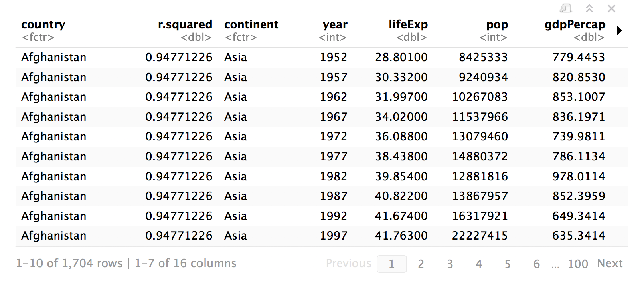
unnest()
Unnests one or more list columns
master %>%
unnest(data, output, .drop = FALSE)
CC BY-SA RStudio

Slide 64
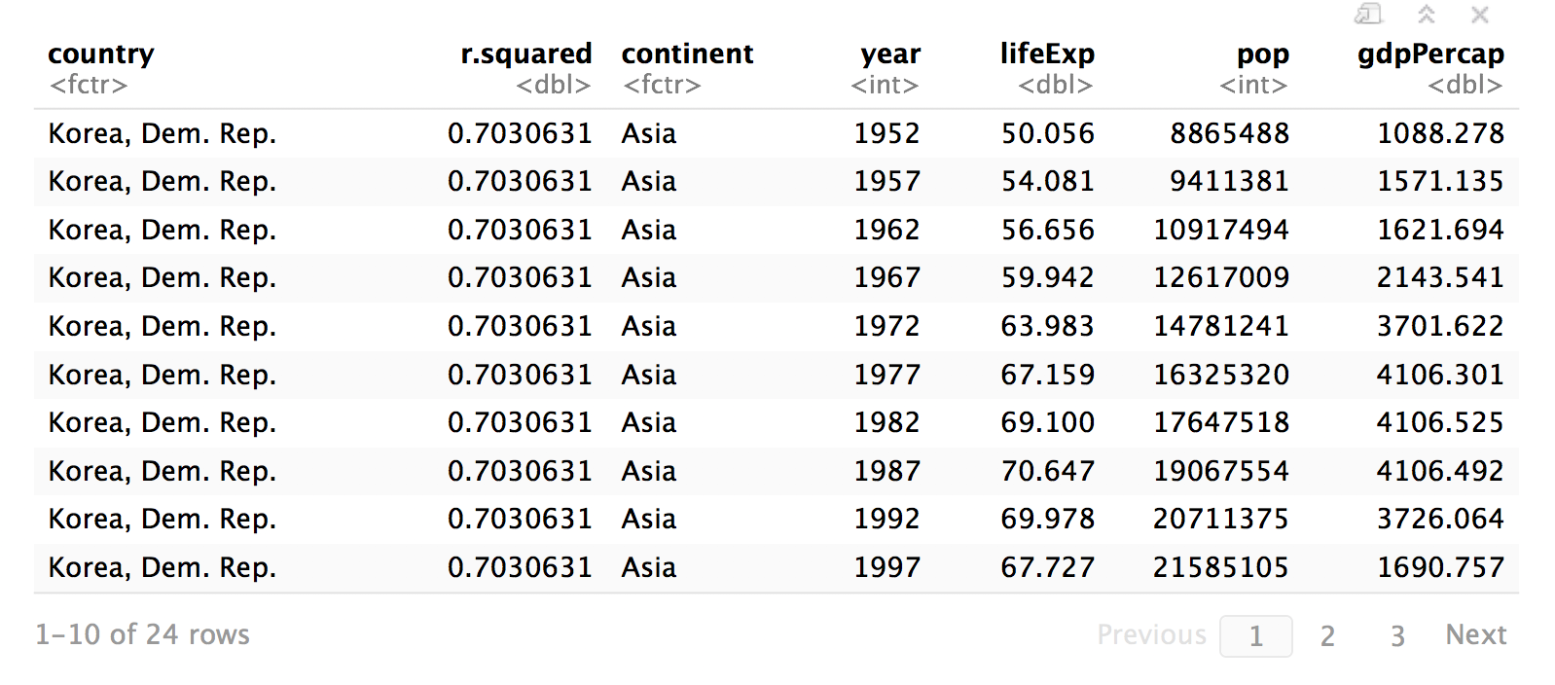
master %>%
filter(str_detect(country, pattern = "Korea")) %>%
unnest(data)
CC BY-SA RStudio

Slide 65
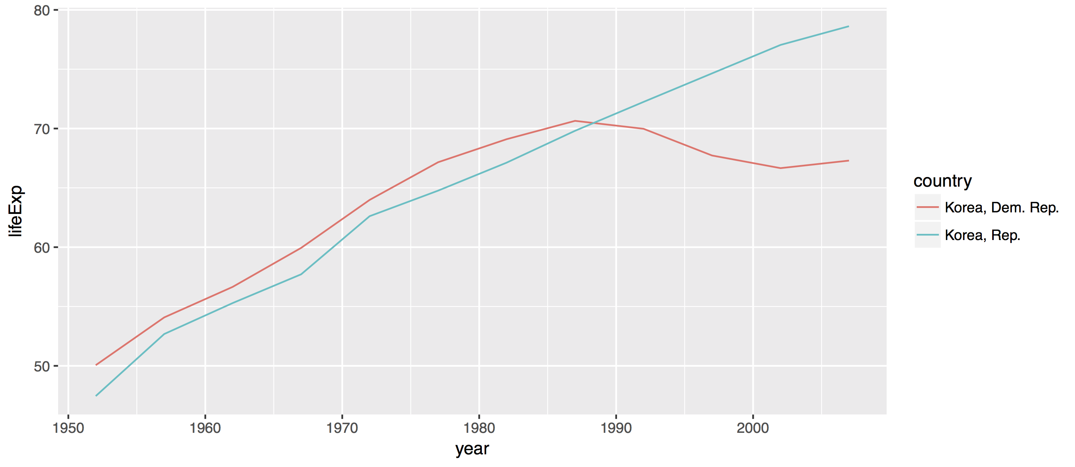
master %>%
filter(str_detect(country, pattern = "Korea")) %>%
unnest(data) %>%
ggplot() +
geom_line(aes(year, lifeExp, color = country))
CC BY-SA RStudio

Slide 66
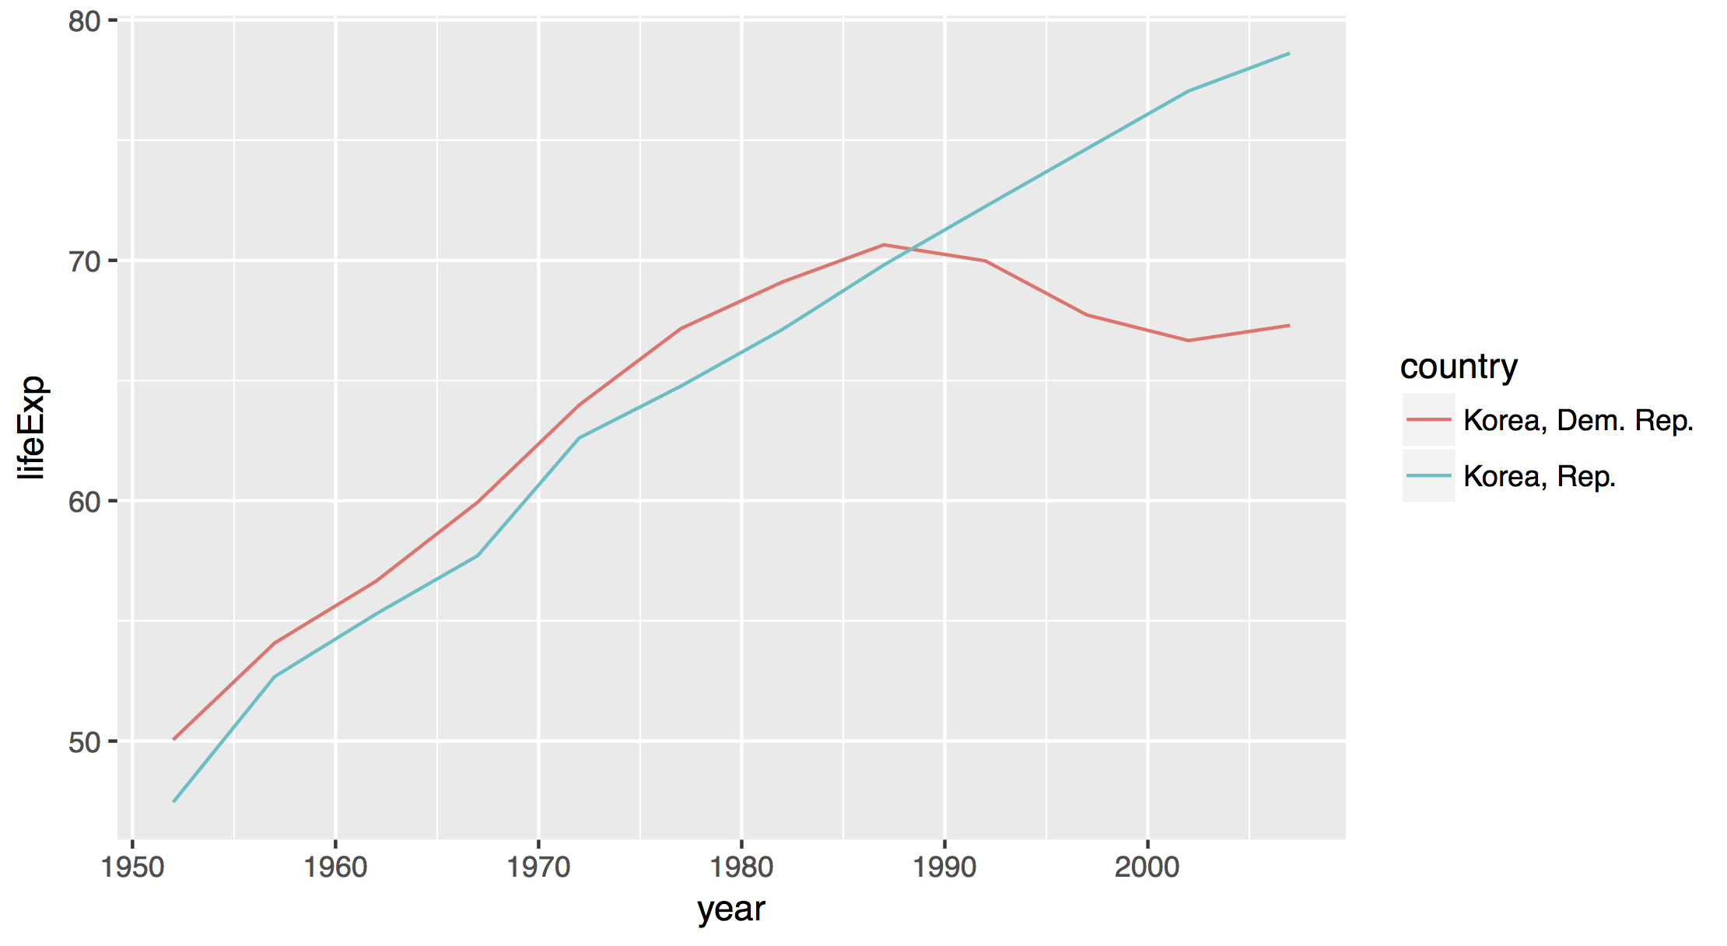
CC BY-SA RStudio

Slide 67
Your Turn 5
Use master to recreate our plot of the residuals vs year for the six countries with an r squared less than 0.25.

Slide 68
master %>%
filter(r.squared < 0.25) %>%
unnest(output) %>%
ggplot() +
geom_line(mapping = aes(x = year, y = .resid, color = country))
CC BY-SA RStudio

Slide 69
Take Away
A table is …an organizational structure …that you can manipulate.
country | r.squared | data | model
Botswana | 0.03
Lesotho | 0.08
Rwanda | 0.02
year | .resid
1952 | -5.3071154
1957 | -3.6144580
1962 | -2.0158007
1967 | -0.5411434
1972 | 1.8815140
1977 | 4.8731713
1982 | 6.7348287
1987 | 8.5694860
1992 | 7.3891434
1997 | -3.1031993
2002 | -9.3285420
2007 | -5.5378846
Call:
lm(formula = lifeExp ~ year, data = .)
Coefficients:
(Intercept) year
-65.49586 0.06067
year | .resid
1952 | -5.2410256
1957 | -2.8098543
1962 | -0.5876830
1967 | -0.3205117
1972 | 0.4766597
1977 | 2.4398310
1982 | 4.8320023
1987 | 6.4561737
1992 | 8.4833450
1997 | 3.8785163
2002 | -7.5643124
2007 | -10.0431410
Call:
lm(formula = lifeExp ~ year, data = .)
Coefficients:
(Intercept) year
-139.16529 0.09557
CC BY-SA RStudio
year | .resid
1952 | -2.7419487
1957 | -1.0127914
1962 | 0.7163660
1967 | 2.0455233
1972 | 2.7746807
1977 | 3.4038380
1982 | 4.8509953
1987 | 2.8821527
1992 | -17.3096900
1997 | -4.5925326
2002 | 2.9626247
2007 | 6.0207821
Call:
lm(formula = lifeExp ~ year, data = .)
Coefficients:
(Intercept) year
-139.16529 0.09557

Slide 70
"Better experimental design = simpler statistics.
Better data model = simpler analysis."
- Jenny Bryan (2016)

Slide 72
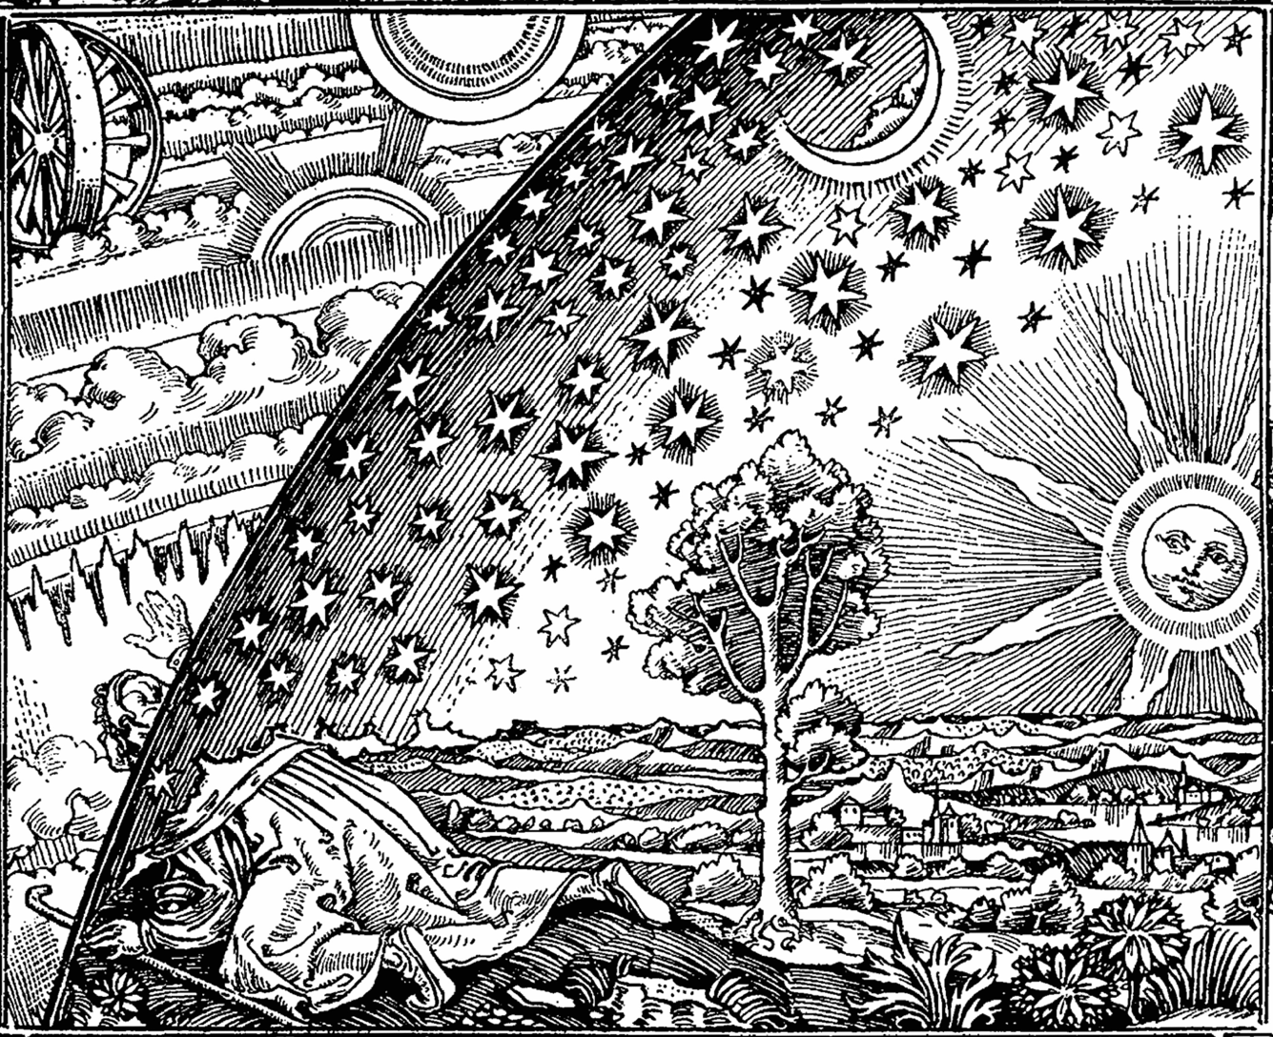
Thank You
CC BY-SA RStudio

Slide 73
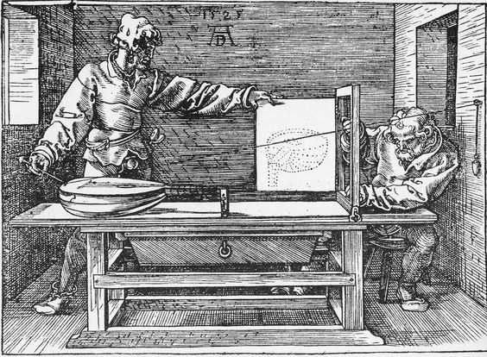
Please take the class survey
www.surveymonkey.com/r/SX9X69R
CC BY-SA RStudio

Slide 74
Solutions at
github.com/rstudio/master-the-tidyverse-solutions
Please take the class survey
www.surveymonkey.com/r/SX9X69R
CC BY-SA RStudio

